Slide 1
Machine Learning Neural Networks
Dr. Ahmed Aljarah

Slide 2
Neural networks
Neural networks are machine learning models inspired by the structure and operation of the human brain.
They are designed to mimic how the brain processes information and perform similar tasks.
They are composed of interconnected nodes, called neurons, that work together to :
Process information
Learn patterns from data
Pattern recognition
Decision-making

Slide 3
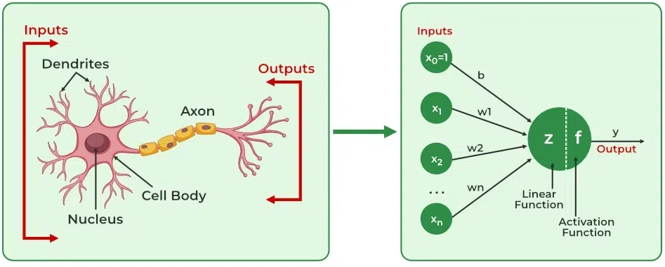
From brain to machine neural networks
Neural networks are computational models that emulate the structure of biological neural systems

Slide 4
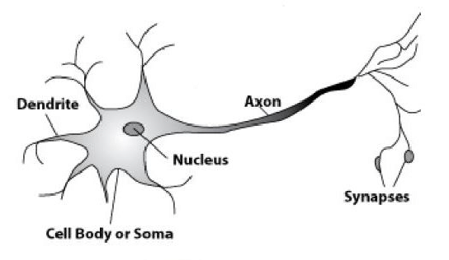
Biological Neuron (Brain)
A neuron in the brain has several main parts:
Dendrites receive signals (inputs) from other neurons
Cell body processes the received information
Nucleus controls neuron activity
Axon carries the signal forward
A synapse is the connection point between two neurons in the brain. It is where the output signal from one neuron is transmitted to another neuron
The outputs send information through the synapse to communicate with other neurons
The biological neuron receives information, processes it, and produces an output signal

Slide 5

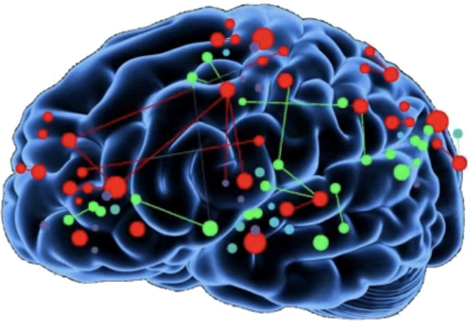
Human brain

Slide 6
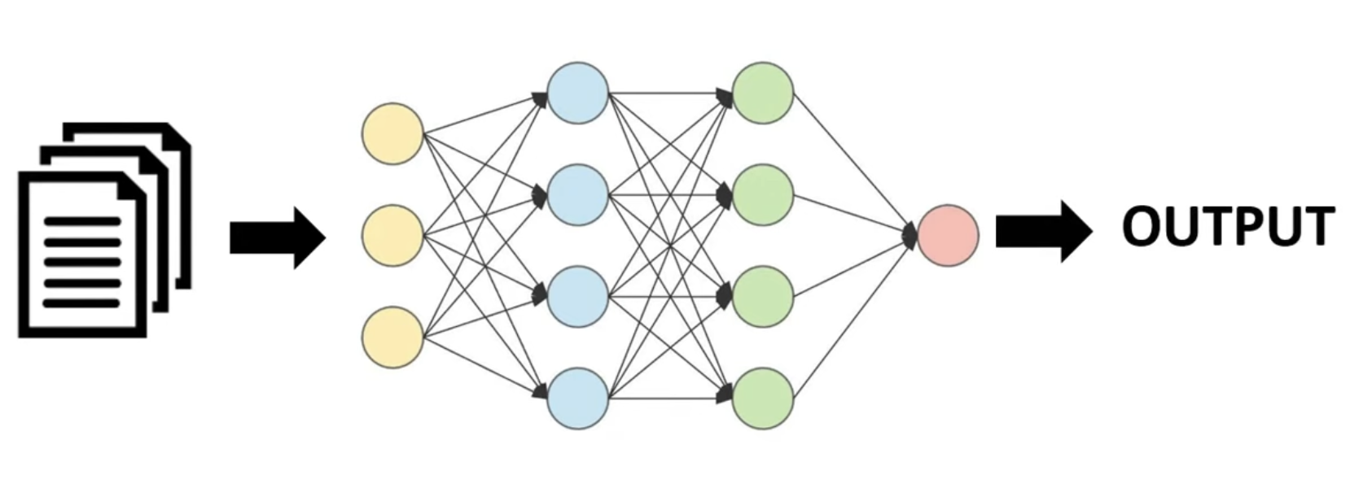
Neural networks in ML

Slide 7
Neural networks components
Neurons: The basic units that receive inputs, calculate f(z) and apply an activation function.
Connections: Links between neurons that carry information, regulated by weights and biases.
Weights and Biases: These parameters determine the strength and influence of connections.
Propagation functions: Mechanisms that help process and transfer data across layers of neurons.
Learning rule: The method that adjusts weights and biases over time to improve accuracy.

Slide 8
Neural networks
Neural networks are systems composed of processing elements (PEs) along with the connections and communication between them.
A processing element is a simplified representation of a biological neuron, commonly referred to as an artificial neuron. Each PE receives input data, processes it, and generates an output.
Neuron
Receives inputs
Multiplies by weights
Adds bias
Applies activation
function Produces output
Neuron
F(x) =0.69

Slide 9
Connections
Connections, also known as synaptic links, are the pathways that connect neurons in a neural network.
They allow information to flow from one neuron to another.
Each connection has a weight, that determines the importance of the signal.
During learning, these weights are adjusted to improve the network’s performance.
a₃
w₁₃
w₃₆
w₂₃
a₁
w₁₄
a₄
w₄₆
a₆
w₁₅
w₂₄
w₅₆
a₂
w₂₅
a₅

Slide 10
Weights and Biases
Weights (w): control the importance of each input
Bias (b): shifts the output value
Help the model adjust and learn patterns
Updated during training to reduce error
b₃
a₃
w₁₃
w₂₃
a₁
w₁₄
b₄
b₆
a₄
w₄₆
a₆
w₁₅
w₂₄
w₅₆
a₂
b₅
w₂₅
a₅

Slide 11
Learning rule
The learning rule defines how a neural network improves by updating its weights and biases based on the error.
Compares predicted output with the correct output
Calculates the error
Adjusts weights and biases to reduce the error
Repeats until the model improves

Slide 12
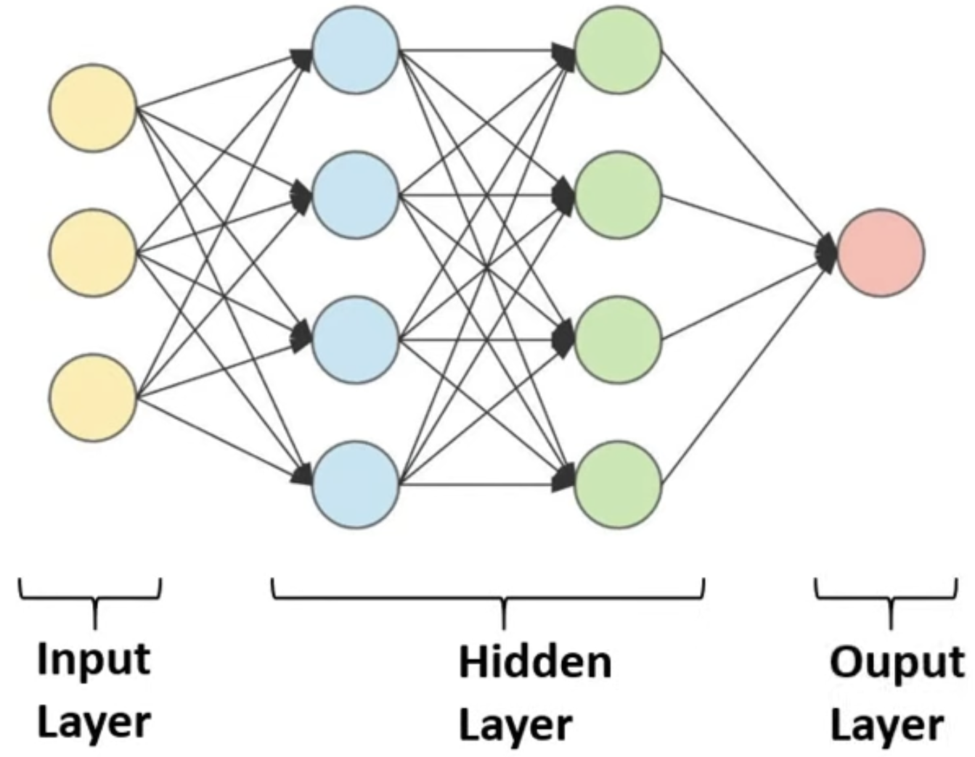
Neural networks layers
Input Layer:
Entry point of the network
Receives raw data (features)
Each neuron = one input feature
Hidden Layers:
Perform the main computations
Learn patterns and relationships in data
Each layer transforms the data step by step
Can have one or multiple layers
Output Layer:
Produces the final prediction
Format depends on the task, Classification or Regression
s

Slide 13
Propagation functions
Forward propagation:
Forward propagation define how data moves and is processed inside a neural network.
Combine inputs using weights and bias
Compute a value called net input (z)
Pass the result to the activation function(Sigmoid, Tanh or ReLU)
Send the output to the next layer

Slide 14
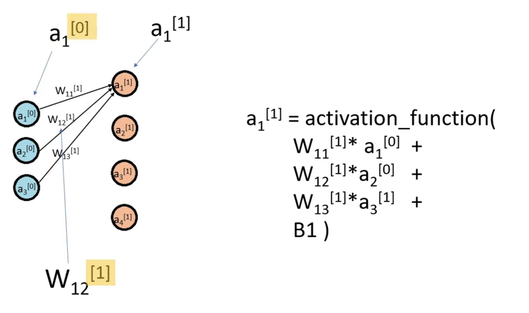

Forward propagation
Forward propagation is the process in a neural network where input data moves through the network layer by layer to produce a prediction.
Input → Hidden → Output
The model:
Takes input data
Processes it through layers
z^{[l]} =W^{[l]} *a^{[l-1]} + b^{[l]}
a^{[l]} = f(z^{[l]} )
Produces an output (prediction)
Then we compare:
Predicted value vs correct answer
This difference is called the error (loss)
$${b_{1}}^{[1]}$$

Slide 15
Forward propagation
From input Layer to hidden Layer1
z₁ = w₁*a₀ +B₁
From hidden Layer1 to hidden Layer2
a₂ = f(z₂)
From hidden Layer2 to output Layer
z₃ = w₃*a₂ +B₃
a₃ = f(z₃) = y_pred
a₁ = f(z₁)
z₂ = w₂*a₁ +B₂
Random weights
After training
Trained weights

Slide 16
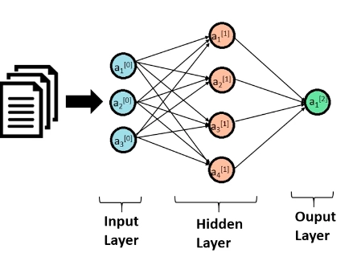
Forward propagation
a₁^{[1]} = activation function(w₁₁^{[1]}* a₁^{[0]}+ w₁₂^{[1]}* a₂^{[0]}+ w₁₃^{[1]}* a₃^{[0]} + B1)
W₁₁^{[1]}
W₁₂^{[1]}
a₂^{[1]}=activation function(w₂₁^{[1]}* a₁^{[0]}+ w₂₂^{[1]}* a₂^{[0]} + w₂₃^{[1]}* a₃^{0]} + B1)

Slide 17
0

Slide 18
Activation functions Types
Output layer:
Binary classicication: Sigmoid function
Multi-class classifiction: Softmax function
Regression: no need for activation function on the output neuron
Hidden layers:
Sigmoid function
Tanh Function
Relu (Rectified Linear Unit) Function

Slide 19
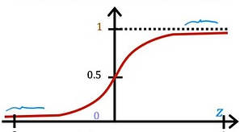

Sigmoid function
f$\left(z\right)=\frac{1}{1+e^{−z}}$
f(z) >= 0.5 → 1
→
f(z) < 0.5 → 0
Output

Slide 20
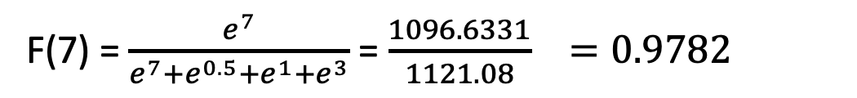
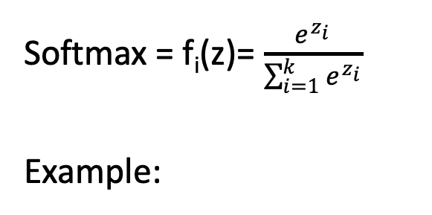
Softmax funtion
z=[z₁​,z₂​,...,z_{k}​] are just scores
Softmax turns them into:
Y_pred=[p₁,p₂,...,p_{k}]
k is total number of classes
Softmax = f_{i}(z​)= $\frac{e^{z_{i}}}{\sum_{i=1}^{k}{e^{z_{i}}}}$
Example:
7
F(7) = $\frac{e^{7}}{e^{7}+e^{0.5}+e^{1}+e^{3}}$ = $\frac{1096.6331}{1121.08} =0.9782$
0.5
F(0.5) = $\frac{e^{0.5}}{e^{7}+e^{0.5}+e^{1}+e^{3}}$ = $\frac{1.6487}{1121.08} =0.00147$
→
F(1) = $\frac{e^{1}}{e^{7}+e^{0.5}+e^{1}+e^{3}}$ = $\frac{2.7182}{1121.08} =0.00242$
1
F(3) = $\frac{e^{3}}{e^{7}+e^{0.5}+e^{1}+e^{3}}$ = $\frac{20.0855}{1121.08} =0.0179$
3

Slide 21
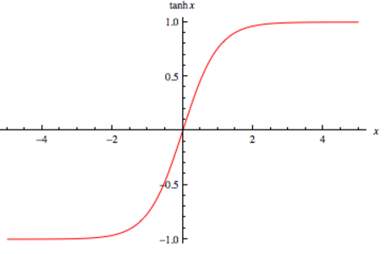

Tanh function
f(z) = $\frac{ e^{z}−e^{−z}}{e^{z}+e^{−z}}$
With tanh values centered around 0
Better balance
Faster convergence:
Has larger gradients
Learning is more efficient

Slide 22
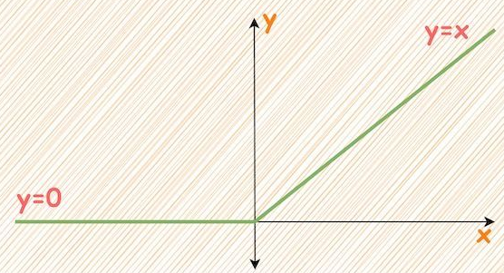
ReLU (Rectified Linear Unit) function
It passes positive values and block negative ones
If x > 0 → output = z
If x ≤ 0 → output = 0
f(z)=max(0,z) →
Examples:
ReLU(5) = 5
ReLU(−3) = 0
ReLU(0) = 0
Piece wise linear

Slide 23
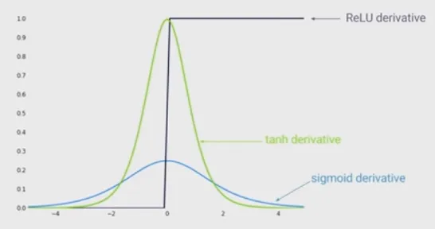
Vanishing gradient problem
It occurs when gradients become very small during backpropagation, causing slow or no learning, especially in deep neural networks.
Gradients move backward through many layers.
Gradients become smaller, making it difficult for deep networks to learn complex patterns.

Slide 24
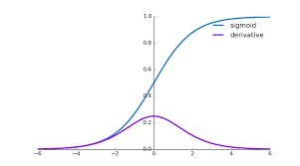
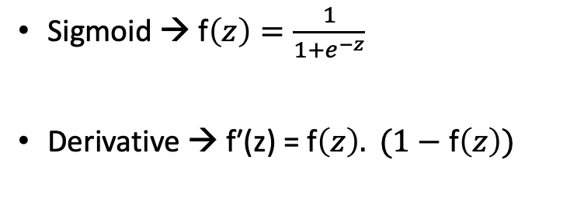
Sigmoid derivative
Sigmoid → f$\left(z\right)=\frac{1}{1+e^{−z}}$
Derivative → f′(z) = f$\left(z\right). (1−\text{f}\left(z\right))$
The maximum derivative of sigmoid is 0.25 this happens at z=0
For very large positive or negative values of z, the derivative becomes close to 0, that contributes to the vanishing gradient problem

Slide 25
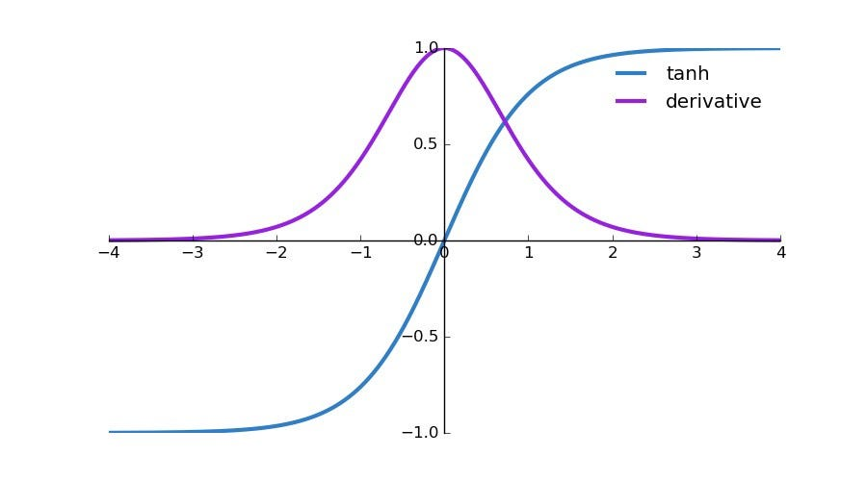

Tanh derivative
Tanh →f(z) = $\frac{ e^{z}−e^{−z}}{e^{z}+e^{−z}}$
Derivative → f′(z) = 1 - (f(z))²
The maximum of the Derivative is 1.
Occurs when f(z)=0
Happens at: z=0, then: f′(0)=1−0²
Tanh has larger gradients, which helps learning happen faster than sigmoid

Slide 26
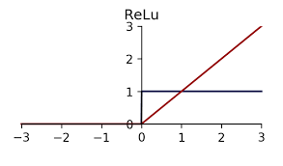
ReLU derivative
If x > 0 → output = z
If x ≤ 0 → output = 0
ReLU f(z)=max(0,z) →
Derivative:
f′(z_{j}​)= 1
→
f′(z_{j}​)= 0
if z > 0
if z​ <= 0

Slide 27
Backpropagation
Backpropagation calculates how much each weight and bias contributed to the prediction error and then adjust those weights to reduce future errors.
It works by sending the error backward through the network, from output layer to input layer.
Moves backward through the network
Measures each layer’s responsibility for the error
Calculates how to adjust weights and bais to reduce it

Slide 28
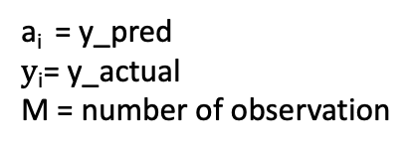
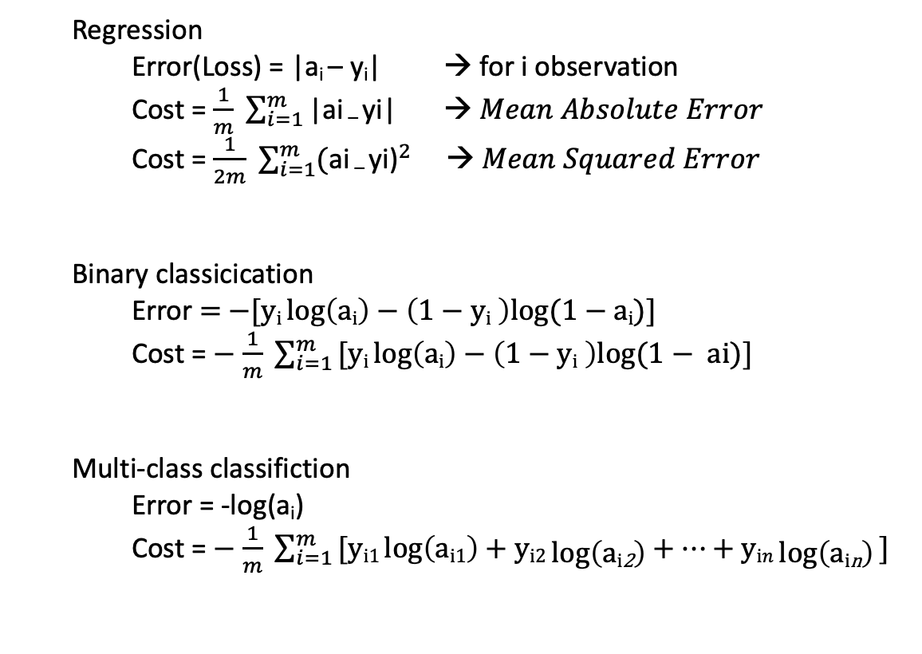
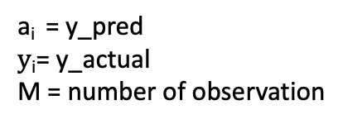
Cost function
Regression
Error(Loss) = |a_{i} – y_{i}| → for i observation
Cost = $\frac{1}{m} \sum_{i=1}^{m}{\text{|}\text{ai}\text{ – }\text{yi}\text{|} → Mean Absolute Error }$
Cost = $\frac{1}{2m} \sum_{i=1}^{m}{{\text{(}\text{ai}\text{ – }\text{yi}\text{)}}^{2} → Mean Squared Error }$
Binary classicication
Error = $−[\text{y}\text{i} log\left(\text{a}\text{i}\right)−\left(1−\text{y}\text{i} \right)log⁡(1−$ a_{i})]
Cost = $−$ $\frac{1}{m} \sum_{i=1 }^{m}{[\text{y}\text{i} log\left(\text{a}\text{i}\right)−\left(1−\text{y}\text{i} \right)log⁡(1− \text{ai}\text{)] }}$
Multi-class classifiction
Error = -log(a_{i})
Cost = $−$ $\frac{1}{m} \sum_{i=1 }^{m}{[\text{y}\text{i}\text{1} log\left(\text{a}\text{i}\text{1}\right)+\text{y}\text{i}2\log\left(\text{a}\text{i}\text{2}\right)+…+\text{y}\text{i}n\log\left(\text{a}\text{i}\text{n}\right)\text{] }}$
a_{i} = y_pred
$y\text{i}$= y_actual
M = number of observation
→
a_{i} = y_pred
$y\text{i}$= y_actual
M = number of observation
→
a_{i} = y_pred
N = class number
M = number of observation
→

Slide 29
Cost
Cost
Weight

Slide 30
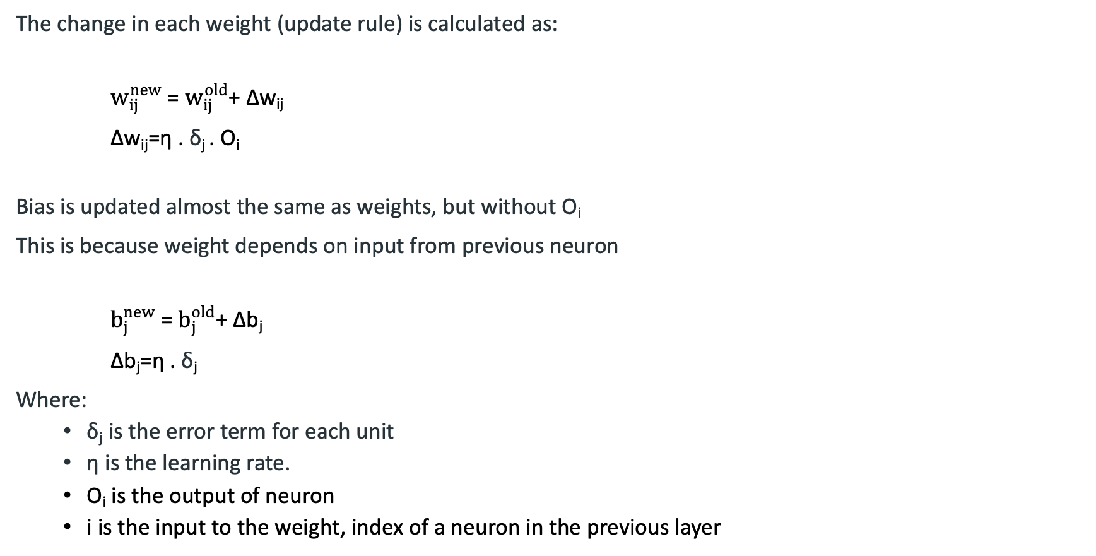
Gradients descent
The change in each weight (update rule) is calculated as:
$w_{ij}^{new}$= $w_{ij}^{old}$+ Δw_{ij}
Δw_{ij}=η . δ_{j} . O_{i}
Bias is updated almost the same as weights, but without O_{i}
This is because weight depends on input from previous neuron
$b_{j}^{new}$= $b_{j}^{old}$+ Δb_{j}
Δb_{j}=η . δ_{j}
Where:
δ_{j}​​ is the error term for each unit
η is the learning rate.
O_{i}​ is the output of neuron
i is the input to the weight, index of a neuron in the previous layer
a_{i}
w_{ij}
a_{j}
O_{i}
δ_{j}

Slide 31
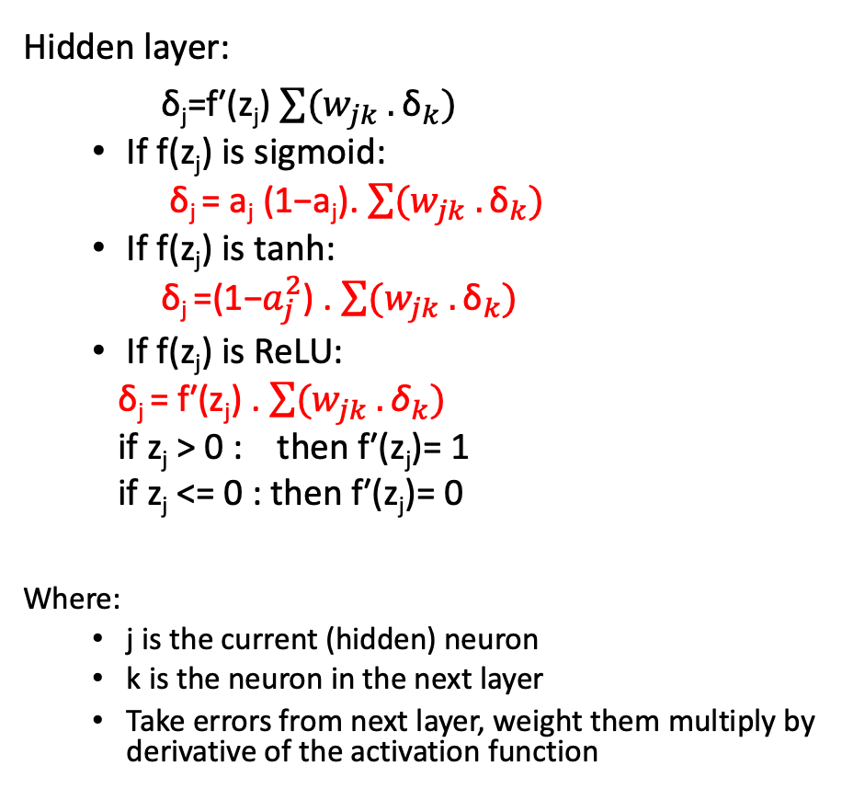
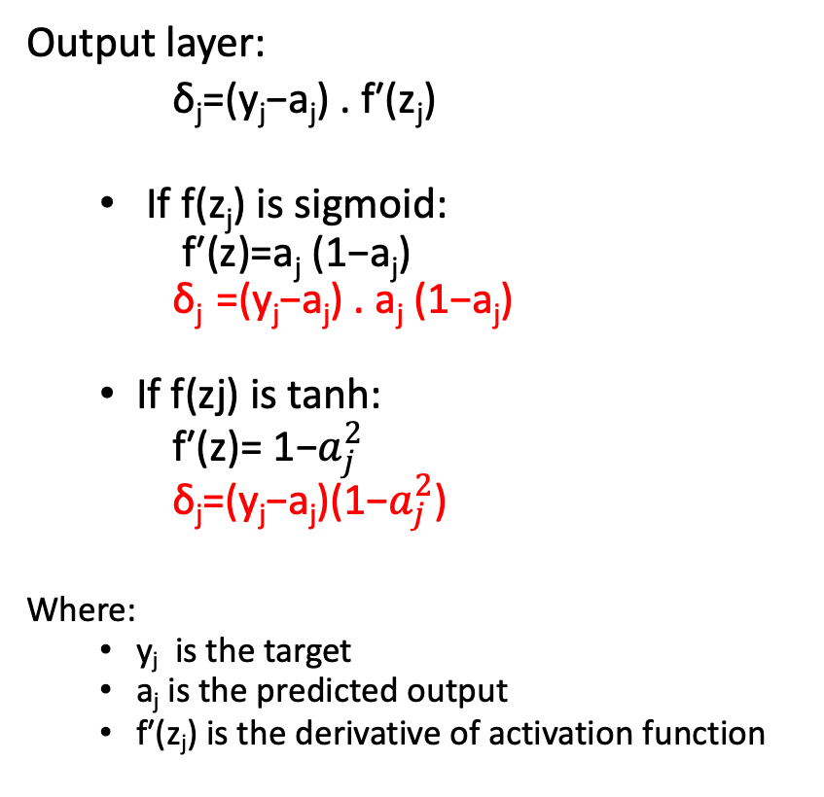
δ_{j​} (error term) calculations
Output layer:
δ_{j​}=(y_{j}​−a_{j}​) . f′(z_{j}​)
If f(z_{j}​) is sigmoid:
f′(z)=​a_{j}​ (1−a_{j}​)
δ_{j​} =(y_{j}​−a_{j}​) . a_{j}​ (1−a_{j}​)
If f(zj​) is tanh:
f′(z)=​ 1−$a_{j}^{2}$
δ_{j}=(y_{j}−a_{j})(1−$a_{j}^{2}$)
Where:
y_{j} is the target
a_{j} is the predicted output
f′(z_{j}) is the derivative of activation function
Hidden layer:
δ_{j​}=f′(z_{j}​) $\sum{(w_{jk} . {\text{δ}}_{k})}$
If f(z_{j}​) is sigmoid:
δ_{j​} = a_{j}​ (1−a_{j}​). $\sum{(w_{jk} . {\text{δ}}_{k})}$
If f(z_{j}​) is tanh:
δ_{j​} =(1−$a_{j}^{2}$) . $\sum{(w_{jk} . {\text{δ}}_{k})}$
If f(z_{j}​) is ReLU:
δ_{j​} = f′(z_{j}​) . $\sum{(w_{jk} . {\text{δ}}_{k})}$
if z_{j}​ > 0 : then f′(z_{j}​)= 1
if z_{j}​ <= 0 : then f′(z_{j}​)= 0
Where:
j is the current (hidden) neuron
k is the neuron in the next layer
Take errors from next layer, weight them multiply by derivative of the activation function

Slide 33
Neral network example
Assume we have a neural network where:
Each neuron uses a sigmoid activation function.
We will perform a forward pass, then a backward pass, and then update the weights.
Actual y = 1 and Learning rate = 0.9
x₁=1
B₄(θ₄) = -0.4
W₁₄= 0.2
H₄
W₁₅= -0.3
W₄₆= -0.3
W₂₄= 0.4
B₆(θ₆) = 0.1
x₂=0
O₆
B₅(θ₅) = 0.2
W₂₅= 0.1
W₅₆= -0.2
H₅
W₃₄= -0.5
x₃=1
W₃₅= 0.2

Slide 34
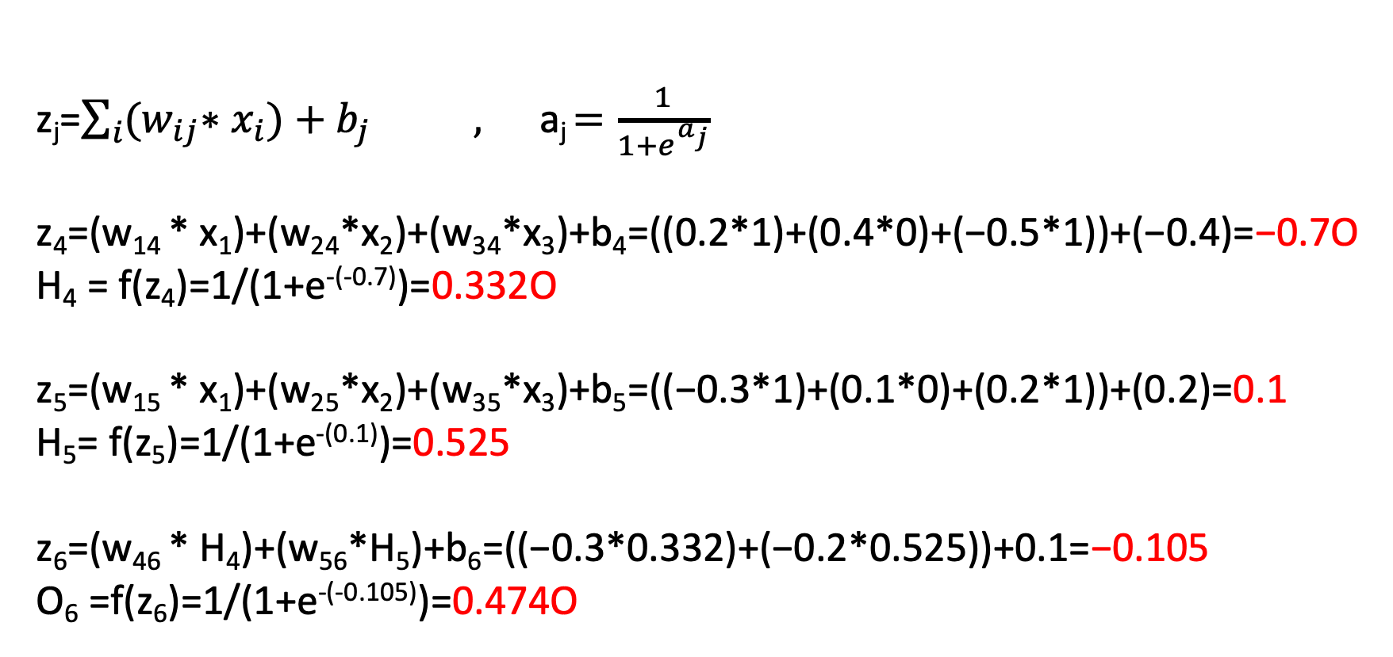
Solution: Step 1: calculate y_pred (a_{j})
z_{j}=$\sum_{i}{{(w}_{ij}∗{ x}_{i})+b_{j}} ,$a_{j} $=\frac{1}{1+e^{a_{j}}}$
z₄​=(w​₁₄ * x₁​)+(w₂₄​*x₂​)+(w₃₄​*x₃​)+b₄​=((0.2*1)+(0.4*0)+(−0.5*1))+(−0.4)=−0.7O
H₄ = f(z₄)=1/(1+e^{-(-0.7)})=0.332O
z₅​=(w​₁₅ * x₁​)+(w₂₅​*x₂​)+(w₃₅​*x₃​)+b₅​=((−0.3*1)+(0.1*0)+(0.2*1))+(0.2)=0.1
H₅= f(z₅)=1/(1+e^{-(0.1)})=0.525
z₆​=(w​₄₆ * H₄​)+(w₅₆​*H₅​)+b₆​=((−0.3*0.332)+(−0.2*0.525))+0.1=−0.105
O₆ =f(z₆)=1/(1+e^{-(-0.105)})=0.474O

Slide 35
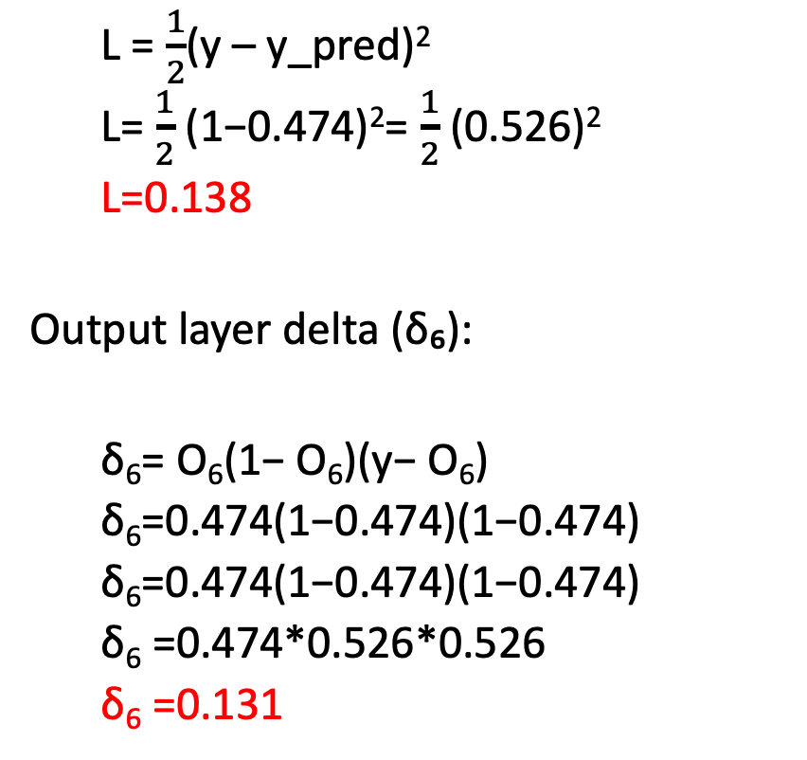
Step 2: Calculate error (Loss)
L = $\frac{1}{2}$(y – y_pred)²
L= $\frac{1}{2}$(1−0.474)²= $\frac{1}{2}$(0.526)²
L=0.138
Output layer delta (δ₆):
δ₆= O₆(1− O₆)(y− O₆)
δ₆=0.474(1−0.474)(1−0.474)
δ₆​=0.474(1−0.474)(1−0.474)
δ₆ =0.474*0.526*0.526
δ₆ =0.131
Hidden layer deltas δ₄ and δ₅:
δ₄=H₄(1−H₄)(δ₆*w₄₆)
δ₄​=0.332(1−0.332)(0.131*−0.3)
δ₄ =0.332 *0.668 * −0.0393
δ₄ =−0.0087
δ₅= H₅(1−H5)(δ6*w56)
δ₅ = 0.525 *(1 − 0.525)(0.131 * −0.2)
δ₅ =0.525*0.475*(−0.0262)
δ₅ =−0.0065

Slide 36
Gradients (ΔW)
Output layer weights w₄₆ and Δw₅₆ :
Δw₄₆=η⋅δ₆⋅H₄
Δw₄₆ =0.9*0.131*0.332
Δw₄₆ =0.039
Δw₅₆=η⋅δ₆⋅H₅
Δw₅₆= 0.9*0.131*0.525
Δw₅₆​=0.062
Hidden layer weights w₁₄, w₂₄ and w₃₄:
Δw₁₄ = η⋅δ₄⋅X₁
Δw₁₄ = 0.9*(−0.0087)*1
Δw₁₄ = − 0.0078
Δw₂₄​= η⋅δ₄⋅X₂
Δw₂₄​= 0.9*(−0.0087)*0
Δw₂₄​= 0
Δw₃₄ = η⋅δ₄⋅X₃
Δw₃₄ =0.9*(−0.0087)*1
Δw₃₄ =−0.0078

Slide 37
Gradients (ΔW)
Hidden layer weights w₁₅, w₂₅ and w₃₅:
Δw₁₅ =η⋅δ₅⋅X₁
Δw₁₅ = 0.9 *−0.0065 *1
Δw₁₅ =−0.0059
Δw₂₅ =η⋅δ₅⋅X₂
Δw₂₅ = 0.9*−0.0065 *0
Δw₂₅ =0
Δw₃₅= η⋅δ₅⋅X₃
Δw₃₅ = 0.9⋅(−0.0065)⋅1
Δw₃₅ = −0.0059
x₁=1
B₄(θ₄) = -0.4
W₁₄= 0.2
H₄
W₁₅= -0.3
W₄₆= -0.3
W₂₄= 0.4
B₆(θ₆) = 0.1
x₂=0
O₆
B₅(θ₅) = 0.2
W₂₅= 0.1
W₅₆= -0.2
H₅
W₃₄= -0.5
x₃=1
W₃₅= 0.2

Slide 38
Step 3: Update weights and bias
Output layer w₄₆_new and w₅₆_new:
w₄₆_new = w₄₆ + Δw₄₆
w₄₆_new= - 0.3+0.039
w₄₆_new = - 0.261
W₅₆_new = w₅₆ + Δw₅₆
W₅₆_new=−0.2+0.062
W₅₆_new =−0.138
Hidden layer w₁₅_new, w₂₅ _new and w₃₅_new:
w₁₅_new = w₁₅ + Δw₁₅
w₁₅_new = -0.3 -0.0059
w₁₅_new = -0.306
w₂₅_new = w₂₅ + Δw₂₅
w₂₅_new = -0.1 + 0
w₂₅_new = 0.1
w₃₅_new = w₃₅ + Δw₃₅
w₃₅_new = 0.2 - 0.0059
w₃₅_new = 0.194
Hidden layer w₁₄_new, w₂₄ _new and w₃₄_new:
w₁₄_new = w₁₄ + Δw₁₄
w₁₄_new = 0.2 − 0.0078
w₁₄_new = 0.192
w₂₄_new = w₂₄ + Δw₂₄
w₂₄_new = 0.4 + 0
w₂₄_new = 0.4
w₃₄_new = w₃₄ + Δw₃₄
w₃₄_new = -0.5 - 0.0078
w₃₄_new = -0.508

Slide 39
Output bias:
b₆_new= b₆ + η.δ₆
b₆_new= 0.1+0.9*0.131
b₆_new =0.218
Hidden bias
H5 bias:
b₅_new= b₅ + η.δ₅
b₅_new= 0.2+0.9* −0.0065
b₅_new =0.194
H4 bias:
b₄_new= b₄ + η.δ₄
b₄_new= -0.4+0.9*−0.0087
b₄_new = -0.408
Updated neural network
x₁=1
B₄(θ₄) = -0.408
W₁₄= 0.192
H₄
W₁₅= -0.306
W₄₆= -0.261
W₂₄= 0.4
B₆(θ₆) = 0.218
x₂=0
O₆
B₅(θ₅) = 0.194
W₂₅= 0.1
W₅₆= -0.138
H₅
W₃₄= -0.508
x₃=1
W₃₅= 0.194

Slide 40
Neural Network Classification Example 1:
Using lode_digits dataset that, consists of 1,797 samples, where each sample is represented as a fixed-size 8×8 matrix.
There are 10 possible classes or labels (0, 1, 2, 3, ..., 9).
Each class contains approximately 180 samples, and the features are integer numbers between 0 and 16.
This dataset is available in Scikit-learn.
In this exercise, you will implement a neural network using the Python library Keras to train and test a model for the automatic recognition of handwritten.

Slide 41
Code
import pandas as pd
import numpy as np
import matplotlib.pyplot as plt
from sklearn.datasets import load_digits
images=load_digits()
images.data.shape
images.target.shape
plt.figure(figsize=(20,8))
for index,(image,label) in enumerate(zip(images.data[0:5],images.target[0:5])):
plt.subplot(1,5,index+1)
plt.imshow(np.reshape(image,(8,8)),cmap=plt.cm.gray_r)
plt.title(f"Training {label}")

Slide 42
from sklearn.model_selection import train_test_split
x_train,x_test,y_train,y_test = train_test_split(samples,labels,test_size=0.2,random_state=100)
from keras.models import Sequential
from keras.layers import Dense
# Define the neural network model
model = Sequential()
model.add(Dense(512, activation='relu', input_shape=(x_train.shape[1],)))
model.add(Dense(256, activation='relu'))
model.add(Dense(128, activation='relu'))
model.add(Dense(64, activation='relu'))
model.add(Dense(32, activation='relu'))
model.add(Dense(16, activation='relu'))
model.add(Dense(10, activation='softmax'))
# Compile the model
model.compile(optimizer='adam',loss='sparse_categorical_crossentropy',metrics=['accuracy'])
# Train the model
model.fit(x_train, y_train, epochs=10, batch_size=200,validation_split=0.2)
# Evaluate the model
test_loss, test_acc = model.evaluate(x_test, y_test)
print('Test accuracy:', test_acc)

Slide 43
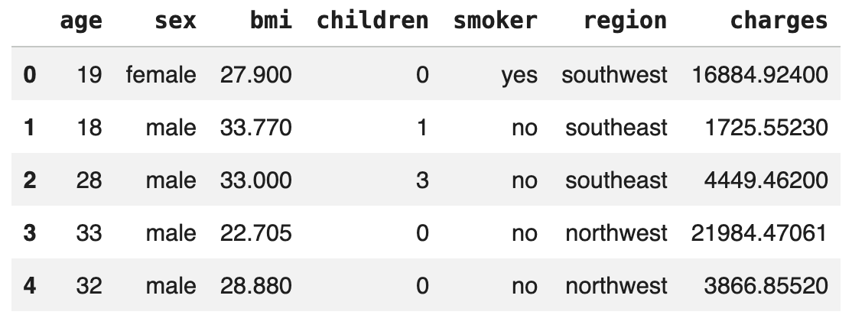
Neural Network Classification Example 2:
Implement a Neural Network Regression model using tensorflow library in python and the following dataset (insurance.csv)

Slide 44
Code
# Importing the libraries
import pandas as pd
import numpy as np
import matplotlib.pyplot as plt
# Importing the dataset
df = pd.read_csv("/content/drive/MyDrive/AI course/insurance.csv")
df.head()
# Analysis the dataset
df.dtypes
df.nunique()
df.isna().sum()
# Encoding categorical data
df = pd.get_dummies(df,drop_first=True)
df.shape

Slide 45
# Data Visualization Building the Correlation matrix
import seaborn as sns
plt.figure(figsize=(12,10))
sns.heatmap(df.corr(), annot = True,cmap="Blues")
#Extracting the Independent and Dependent variables
x = df.drop("charges",axis=1)
y = df["charges"]
x.head()
y.head()
# Splitting the dataset into the Training set and Test set
from sklearn.model_selection import train_test_split
x_train,x_test,y_train,y_test = train_test_split(x,y,test_size=0.2, random_state=2)

Slide 46
# Built the model and Fitting the Training set
import tensorflow as tf
model = tf.keras.Sequential([
tf.keras.layers.Dense(256, activation='relu', input_shape=(x_train.shape[1],)),
tf.keras.layers.Dense(128, activation='relu'),
tf.keras.layers.Dense(64, activation='relu'),
tf.keras.layers.Dense(32, activation='relu'),
tf.keras.layers.Dense(16, activation='relu'),
tf.keras.layers.Dense(8, activation='relu'),
tf.keras.layers.Dense(1)]) model.compile(optimizer='adam',loss='mse',metrics=['mae']) model.fit(x_train,y_train,epochs=100,validation_split=0.2)
# Model evaluation
loss, mae = model.evaluate(x_test, y_test) print("Loss (MSE):", loss)
print("MAE:", mae)
from sklearn.metrics import r2_score y_pred = model.predict(x_test) print("R2 Score:", r2_score(y_test, y_pred))

